Slide 1

Final Project Presentation
Department of Electrical and Computer Engineering
Tandon School of Engineering, New York University
Present By: Haoze He
NYUID: hh2537

Slide 2
01 / Executive Summary
02 / Approach
Agenda
03 / Main Results
04 / Observation & Conclusion
05 / GitHub Link

Slide 3
Executive Summary
Asynchronized SGD
Advantages
Disadvantages
Non-Block SGD
High accuracy
Waste time, Slow converge
High accuracy as ASSGD
Similar time usage as SSGD
Synchronous SGD
Advantages
Disadvantages
Time saving
Lower accuracy
Notes:
Non-Blocking Synchronize Stochastic Gradient Descent: Achieve accuracy as high as ASSGD and similar time using as SSGD

Slide 4
Approach A – Synchronize SGD
Batch size =256
Cons: Waste time
: Communication time
Worker 1
0
Free
1
Free
Worker 2
0
Free
1
Free
Parameter Server
Param. Version
0
1
Worker 3
0
1
Worker 4
0
Free
1
Free

Slide 5
Approach B – Asynchronized SGD
Batch size =256
Cons: Lower Accuracy
: Communication time
Worker 1
0
2
6
Worker 2
0
1
3
Parameter Server
Param. Version
4
6
3
1
5
0
2
Worker 3
0
4
Worker 4
0
5

Slide 6
Approach C – Non-Block SGD
Batch size = 256
Mini-batch size = 32
* : Unfinished part and communication time
Worker 1
…
0-01
0-02
0-03
1-06
0-04
1-07
*0-06
0-05
Worker 2
…
1-1
0-01
0-07
1-3
0-08
0-02
1-2
0-03
0-04
0-06
0-05
Parameter Server
Param. Version
…
0
1
Worker 3
…
0-04
1-06
0-01
0-03
*0-05
0-02
1-05
Worker 4
0-03
…
0-04
1-07
0-02
0-05
0-01
*0-06
1-06

Slide 7
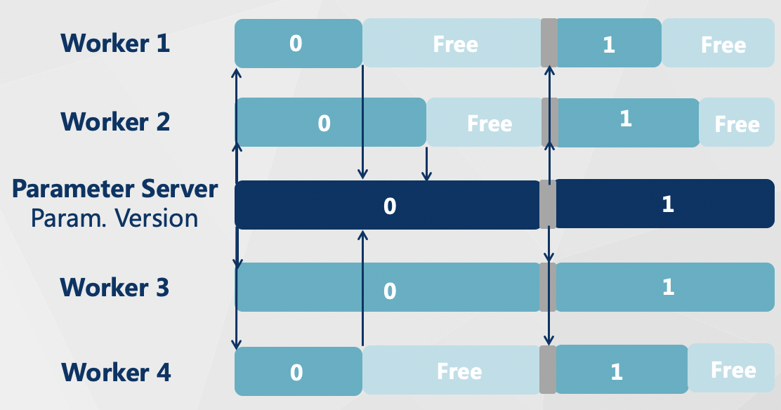
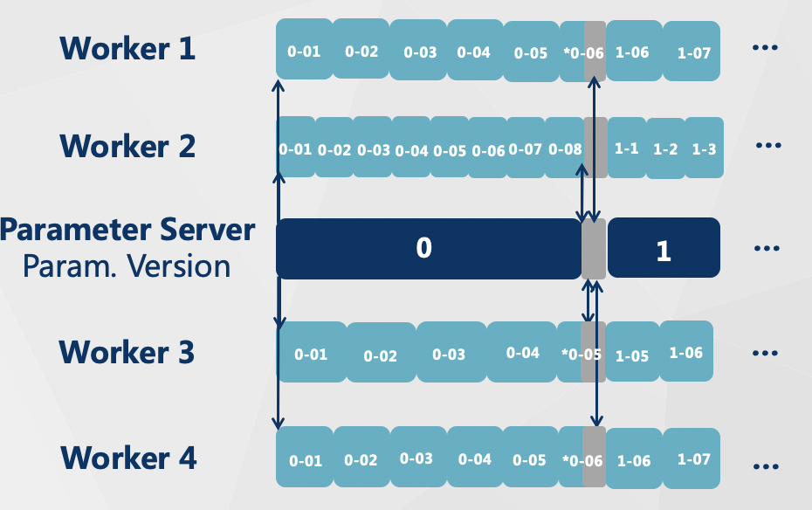
Differences – Synchronized SGD and Non-Block SGD
Synchronized SGD
Non-Block SGD
The proportion of free time remains large even though we set the batch size relatively small, especially when the large performance gap is huge in different workers
By using mini-batch size, we can decrease the proportion of free time dramatically

Slide 8
Approach - Implementation
Hardware Approach
Model Used
Results are test on the NYU Greene HPC clusters with mi50 nodes. To get computing resources shortly, I use multiple CPU nodes as workers and the parameter server instead of multiple GPUs (will be hard to get resources).
I utilize RESNET50 model and CIFAR10 datasets to test the final accuracy of communication scheme.
Performance Test
Code Approach
We use PyTorch programs to observe the effect and test our method and measure the TTA as well as the final accuracy compared to other methods such as ASGD, HOGWILD(SGD), Downpour. Timing(TTA) and accuracy are tested.
Using torch.Distributed and MPI as a backend to build the communication scheme. Run the code on NYU HPC with multiple nodes. Single CPU/task per node.
Notes:
1:Hardware Approach: I can start from simple ones using existing resources: the NYU Greene HPC clusters mi50. To get computing resources shortly, I use multiple CPU-nodes as workers and the parameter server instead of multiple-gpus(will be hard to get resources)
2:Code Approach: Using torch. Distributed and mpi as backend to build the communication scheme. Run the code on NYU HPC with multiple nodes. Single cpu/task per node.
4:Model used: I utilize RESNET50 and CIFAR10 and models and dataset to test the communication scheme
3:Performance Test: We use PyTorch programs to observe the effect and test our method and measure the TTA as well as the final accuracy comparing to other method such as ASGD, HOGWILD(SGD), Downpour. Timing(TTA) and accuracy are tested

Slide 9
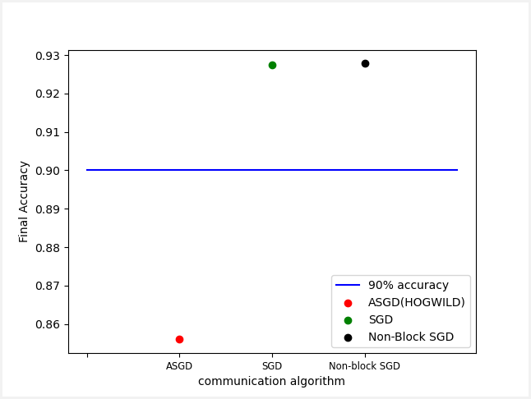
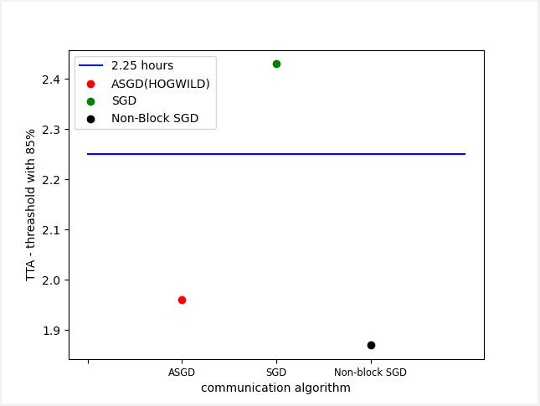
Main Results
Results are got from average among 5 experiments with the same configurations
Non-block SGD has around 23% more time saving than SGD

Slide 10
Observations & Conclusions
Non-blocking SGD has similar accuracy to SGD and is much higher than ASGD
Non-blocking SGD has a similar TTA to ASGD and is much quicker than SGD
Non-blocking SGD has even better TTA than ASGD when a threshold is high enough(85%)

Slide 11
GitHub Link
GitHub Link: https://github.com/HectorHHZ/HPML

Slide 12
THANK YOU!

